Slide 1

Introduction to Revit 2011 API
Adam Nagy and Saikat Bhattacharya
Developer Technical Services
Notes:
AEC Title

Slide 2

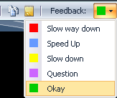
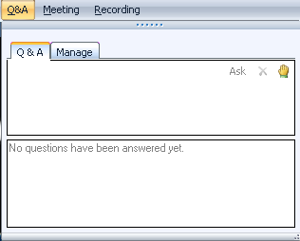
Before we start LiveMeeting and conference call – how to
Use Internet Audio
Full Screen Mode
Provide feedback
Real-time Q&A
Mute phone *6
Expand to full screen mode
Press ESC to return
Notes:
This conference is muted, so you cannot hear anybody else than me talking, and cannot provide feedback through the phone conference. We will unmute it and open it up for general discussion and questions and answers at the end. Meanwhile, written questions can be entered in the live meeting console and will be answered in real-time during the presentation by my colleagues. Thank you very much for that support! Since I will be switching back and forth between these slides and live demonstrations in Revit and Visual Studio, I will set my computer to low resolution and full screen mode to reduce bandwidth and speed up the display. This means I will not see the live meeting console and the feedback panel. My colleagues will be monitoring the livemeeting console and also answering questions online. We will post the materials from this presentation together with the audio recording. We encourage you to use the live meeting internet audio facility, rather than the telephone conference call.

Slide 3
Today’s presentations…
Recorded and posted at:
ADN Extranet
http://adn.autodesk.com
Revit > Knowledgebase > Whitepapers and Training Videos
Developer Center
API Training & Consulting > Schedule
http://www.autodesk.com/joinadn

Slide 4
Polls

Slide 5
Agenda
Introduction
Products, SDK, documentation and samples
Getting Started and Hello World
Development environment, Revit Add-inds: external command and application, add-ins manifest, RvtSamples and RevitLookup (formally known as RvtMgdDbg)
Database Fundamentals
Understanding the representation of Revit element
Element iteration, filtering and queries
Element modification
Model creation
Break
UI Topics
Ribbon, selection, task dialog, event and dynamic model update
Next Steps
Notes:
Next steps – we cannot cover all in this one webcast. We will point to the learning resources and opportunities.

Slide 6
Overview
Products, SDK and assembly dlls
Notes:
That concludes the introduction. Now let us start looking at real development issues and take our first steps up to a simple “Hello World” example. The accompanying labs demonstrate the concepts discussed. They can also be used for self-learning, and as a reference to answer the most common Revit API beginner’s questions.

Slide 7
Revit Products
Three flavours of Revit product and API
Revit Architecture
Revit MEP (Mechanical, Electrical, Plumbing)
Revit Structure
Product build and distribution
DVD version posted to ADN member web site
Software & Support > Revit > Downloads
Posted once only at initial product release time
Web version and Web Update version on Autodesk home page
Products > Autodesk Revit Architecture/MEP/Structure > Product Download
Latest download version from the public product site
Service pack technology since 2009 WU2. No more full install

Slide 8
Revit API Assembly Dll’s
Revit API assembly dll’s are present in every Revit installation
RevitAPI.dll
RevitAPIUI.dll
Since Revit 2011, dll’s are split between DB and UI modules. With Revit 2010 and before, only RevitAPI.dll exists.
Revit Architecture, Structure and MEP flavours
Same API dll’s
Certain functionality only in Architecture, MEP or Structure
Notes:
The Revit SDK is basically purely for support and documentation purposes. All you actually need to develop a Revit add-in is the development environment and the RevitAPI.dll, nothing else. The SDK install is located under the 'Install Tools and Utilities' menu on the main page of the Revit installer. (Note: there is another menu called “Utilities” you see right after the product installation, which contains only the link Content Batch utilities. Click on “Back to First Page” button to move back to the main page of the installer to install SDK.) Alternatively, you can also find the SDK in the extraction folder, under:
<extraction folder>\support\SDK\RevitSDK.exe
If you have accepted the default location, which typically looks like:
C:\Program Files\Autodesk\Revit XXX 2010 support\SDK\RevitSDK.exe
The SDK was recently modified, so please download the the latest update from the developer center. We are already updating the developer guide.

Slide 9
Revit API and SDK
The SDK is provided with the product
From Installer under “Install Tools and Utilities”
Web and download version
<extraction folder>\support\SDK\RevitSDK.zip
or Revit2010SDK.exe
SDK Installer in Revit 2011 RTM temporary setup files
C:\Autodesk\RAC_2011_English_Win_32bit\support\SDK\RevitSDK.exe
Latest SDK update will be posted to Revit Developer Center
http://www.autodesk.com/developrevit
Notes:
The Revit SDK is basically purely for support and documentation purposes. All you actually need to develop a Revit add-in is the development environment and the RevitAPI.dll, nothing else. The SDK install is located under the 'Install Tools and Utilities' menu on the main page of the Revit installer. (Note: there is another menu called “Utilities” you see right after the product installation, which contains only the link Content Batch utilities. Click on “Back to First Page” button to move back to the main page of the installer to install SDK.) Alternatively, you can also find the SDK in the extraction folder, under:
<extraction folder>\support\SDK\RevitSDK.exe
If you have accepted the default location, which typically looks like:
C:\Program Files\Autodesk\Revit XXX 2010 support\SDK\RevitSDK.exe
The SDK was recently modified, so please download the the latest update from the developer center. We are already updating the developer guide.

Slide 10
SDK Documentation
Read once
Read Me First.doc
Getting Started with the Revit API.doc
Revit Platform API Changes and Additions.doc
Revit 2011 API Namespace Remapping.xlsx
Keep at hand always
Revit 2011 API Developer Guide.pdf
RevitAPI.chm
What's New section is similar to Changes and Additions doc
Read if needed
RevitAddInUtility.chm – installer
Autodesk Icon Guidelines.pdf – user interface
Revit Structure – section definitions and material properties
Very important utilities
Add-In Manager
RevitLookup
VSTA Samples
Samples
RevitAPIDllsPathUpdater.exe; SamplesReadMe.htm; SDKSamples2011.sln
Notes:
Here are the top level contents of the SDK. The contents of the Getting Started document have changed from previous versions, because the RevitAPI.chm help file now includes a What's New section. This used to be in the Getting Started document. This information is duplicated in the Changes and Additions document. The Developer Guide is very comprehensive. The Class Diagram provides an object model, actually the class hierarchy. The Revit SDK samples provide a huge knowledgebase on how to address specific programming tasks using the Revit API. The API documentation in the help file lists all the classes and their methods and properties, and the developer guide and samples explain and demonstrate how they work together to solve specific tasks.

Slide 11
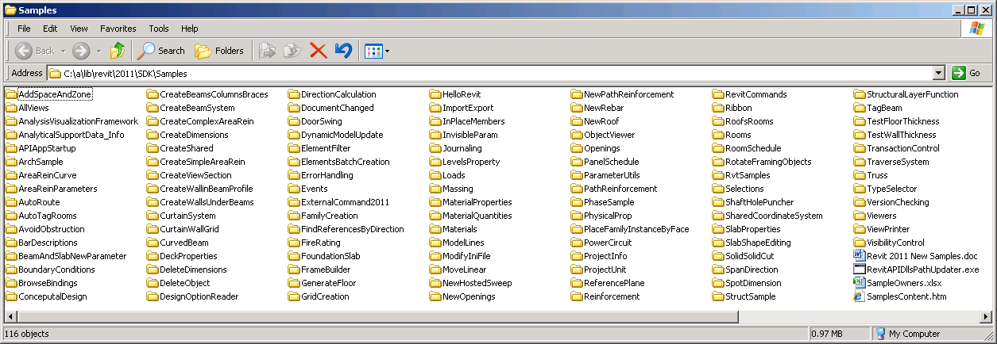
SDK Samples
Documentation
SamplesReadMe.htm
Revit 2011 New Samples.doc
Utility
RevitAPIDllsPathUpdater.exe
Main samples solution
SDKSamples2011.sln
And the samples themselves!
Notes:
The Revit SDK samples provide a huge knowledge base on how to address specific programming tasks using the Revit API. The API documentation in the help file lists all the classes and their methods and properties, and the developer guide and samples explain and demonstrate how they work together to solve specific tasks.

Slide 12
Extending Revit
1. External command
Implement IExternalCommand
Commands are added to the External Tools pulldown in the ribbon Add-Ins tab
Tools > External Tools
2. External application
Implement IExternalApplication
Applications can create new panels in the ribbon Add-Ins tab
External applications make use of external commands, so 1. is a subset of 2.
1 & 2 are listed in .add-in manifest files
3. Visual Studio Tools for Application (VSTA) macro ^{*)} not today’s focus
Two types of macros: application and document level
Almost identical syntax and functionality as external command with few exceptions
References the same RevitAPI.dll & RevitAPIUI.dll since Revit 2011 (no more proxy dll)
Notes:
We have two flavours of Revit add-in, the external command and the external application. An external application can define a user interface by creating its own panel in the ribbon add-ins tab. Within the panel, widgets are defined which are hooked up with external commands implementing the application functionality. An external command listed in Revit.ini is always added to the add-ins tab under the External Tools pulldown.
Today we focus on 1 & 2.

Slide 13
Revit API DLL
.NET API
Microsoft Visual Studio 2008
Microsoft .NET Framework 3.5
C# or VB.NET, managed C++, any .NET compliant language
Class library
References
<revit install folder>\Program\RevitAPI.dll
<revit install folder>\Program\RevitAPIUI.dll
(Remember to set 'Copy Local' to False)
Notes:
The Autodesk Revit API requires the Microsoft .NET Framework v3.5. For examples of flavour specific API functionality, room-related functionality is available in RAC only, the analytical model only in RST, systems only in RME.

Slide 14
Getting Started
First Steps to Hello World: External command and add-ins manifest
Notes:
That concludes the introduction. Now let us start looking at real development issues and take our first steps up to a simple “Hello World” example. The accompanying labs demonstrate the concepts discussed. They can also be used for self-learning, and as a reference to answer the most common Revit API beginner’s questions.

Slide 15
External Command Steps to Hello World
MSVS new class library
References (minimum):
System.dll
RevitAPI.dll
RevitAPIUI
Namespaces (minimum): ^{(*)}
Autodesk.Revit.DB
Autodesk.Revit.UI
Autodesk.Revit.ApplicationServices
Autodesk.Revit.Attributes
Implement IExternalCommand and Execute() method
Register with an “add-in manifest” file
^{(*)} if you use VB.NET, set namespaces in project properties

Slide 16
Implementing External Command Minimum Code in VB.NET
<VB.NET>
'' Hello World #1 - A minimum Revit external command.
<Autodesk.Revit.Attributes.Transaction(Autodesk.Revit.Attributes.TransactionMode.Automatic)> _
<Autodesk.Revit.Attributes.Regeneration(Autodesk.Revit.Attributes.RegenerationOption.Manual)> _
Public Class HelloWorld
Implements IExternalCommand
Public Function Execute( _
ByVal commandData As Autodesk.Revit.UI.ExternalCommandData, _
ByRef message As String, _
ByVal elements As Autodesk.Revit.DB.ElementSet) _
As Autodesk.Revit.UI.Result _
Implements Autodesk.Revit.UI.IExternalCommand.Execute
Autodesk.Revit.UI.TaskDialog.Show("My Dialog Title", "Hello World!")
Return Result.Succeeded
End Function
End Class </VB.NET>

Slide 17
Implementing External Command Minimum Code in C#
<C#> // Hello World #1 - A minimum Revit external command.
[Autodesk.Revit.Attributes.Transaction(Autodesk.Revit.Attributes.TransactionMode.Automatic)]
[Autodesk.Revit.Attributes.Regeneration(Autodesk.Revit.Attributes.RegenerationOption.Manual)]
public class HelloWorld : IExternalCommand
{
public Autodesk.Revit.UI.Result Execute(
Autodesk.Revit.UI.ExternalCommandData commandData,
ref string message,
Autodesk.Revit.DB.ElementSet elements)
{
Autodesk.Revit.UI.TaskDialog.Show("My Dialog Title", "Hello World!");
return Result.Succeeded;
}
} </C#>

Slide 18
Implementing External Command IExternalCommand Class
<VB.NET>
'' Hello World #1 - A minimum Revit external command.
<Autodesk.Revit.Attributes.Transaction(Autodesk.Revit.Attributes.TransactionMode.Automatic)> _
<Autodesk.Revit.Attributes.Regeneration(Autodesk.Revit.Attributes.RegenerationOption.Manual)> _
Public Class HelloWorld
Implements IExternalCommand
Public Function Execute( _
ByVal commandData As Autodesk.Revit.UI.ExternalCommandData, _
ByRef message As String, _
ByVal elements As Autodesk.Revit.DB.ElementSet) _
As Autodesk.Revit.UI.Result _
Implements Autodesk.Revit.UI.IExternalCommand.Execute
Autodesk.Revit.UI.TaskDialog.Show("My Dialog Title", "Hello World!")
Return Result.Succeeded
End Function
End Class </VB.NET>
1.Derive a class from IExternalCommand

Slide 19
Implementing External Command Execute() Method
<VB.NET>
'' Hello World #1 - A minimum Revit external command.
<Autodesk.Revit.Attributes.Transaction(Autodesk.Revit.Attributes.TransactionMode.Automatic)> _
<Autodesk.Revit.Attributes.Regeneration(Autodesk.Revit.Attributes.RegenerationOption.Manual)> _
Public Class HelloWorld
Implements IExternalCommand
Public Function Execute( _
ByVal commandData As Autodesk.Revit.UI.ExternalCommandData, _
ByRef message As String, _
ByVal elements As Autodesk.Revit.DB.ElementSet) _
As Autodesk.Revit.UI.Result _
Implements Autodesk.Revit.UI.IExternalCommand.Execute
Autodesk.Revit.UI.TaskDialog.Show("My Dialog Title", "Hello World!")
Return Result.Succeeded
End Function
End Class </VB.NET>
2.Implement Execute() method
Arguments:
1st Access to the Revit object model
2nd Message to the user when a command fails
3rd A set of elements to be highlighted when a command fails
Return value:
Succeeded
Failed
Cancelled

Slide 20
Implementing External Command Attributes
<VB.NET>
'' Hello World #1 - A minimum Revit external command.
<Autodesk.Revit.Attributes.Transaction(Autodesk.Revit.Attributes.TransactionMode.Automatic)> _
<Autodesk.Revit.Attributes.Regeneration(Autodesk.Revit.Attributes.RegenerationOption.Manual)> _
Public Class HelloWorld
Implements IExternalCommand
Public Function Execute( _
ByVal commandData As Autodesk.Revit.UI.ExternalCommandData, _
ByRef message As String, _
ByVal elements As Autodesk.Revit.DB.ElementSet) _
As Autodesk.Revit.UI.Result _
Implements Autodesk.Revit.UI.IExternalCommand.Execute
Autodesk.Revit.UI.TaskDialog.Show("My Dialog Title", "Hello World!")
Return Result.Succeeded
End Function
End Class </VB.NET>
3. Set attributes
A Transaction mode: controls the behavior transaction
Automatic
Manual
ReadOnly
Regeneration option: controls graphical re-generatation
Automatic
Manual

Slide 21
Implementing External Command Show Hello World
<VB.NET>
'' Hello World #1 - A minimum Revit external command.
<Autodesk.Revit.Attributes.Transaction(Autodesk.Revit.Attributes.TransactionMode.Automatic)> _
<Autodesk.Revit.Attributes.Regeneration(Autodesk.Revit.Attributes.RegenerationOption.Manual)> _
Public Class HelloWorld
Implements IExternalCommand
Public Function Execute( _
ByVal commandData As Autodesk.Revit.UI.ExternalCommandData, _
ByRef message As String, _
ByVal elements As Autodesk.Revit.DB.ElementSet) _
As Autodesk.Revit.UI.Result _
Implements Autodesk.Revit.UI.IExternalCommand.Execute
Autodesk.Revit.UI.TaskDialog.Show("My Dialog Title", "Hello World!")
Return Result.Succeeded
End Function
End Class </VB.NET>
4. Show a dialog with a message
Task Dialog:
Revit-style message box to say “Hello World”

Slide 22
Add-in Manifest Registration Mechanism
New in 2011
Automatically read by Revit at startup
(used of Revit.ini file remains in 2011. Will be discontinued in future releases)
Two locations: All Users, and <user> specific location
Windows XP
C:\Documents and Settings\All Users\Application Data\Autodesk\Revit\Addins\2011\
C:\Documents and Settings\<user>\Application Data\Autodesk\Revit\Addins\2011\
Vista/Windows 7
C:\ProgramData\Autodesk\Revit\Addins\2011\
C:\Users\<user>\AppData\Roaming\Autodesk\Revit\Addins\2011\

Slide 23
Add-in Manifest .addin File
<?xml version="1.0" encoding="utf-8" standalone="no"?>
<RevitAddIns>
<AddIn Type="Command">
<Text>Hello World</Text>
<FullClassName>RevitIntroVB.HelloWorld</FullClassName>
<Assembly>C:\RevitAPI 2011\RevitIntro\bin\HelloWorld.dll</Assembly>
<AddInId>0B997216-52F3-412a-8A97-58558DC62D1E</AddInId>
</AddIn>
</RevitAddIns>
Information about:
Type of the add-in: command or application
Text that appears in Revit under [Add-Ins] tab >> [External Tools] panel
Full class name including namespace
Full path to the dll
GUID or a unique identifier of the command
More options
See Developer Guide section 3.4.1 (pp40)

Slide 24
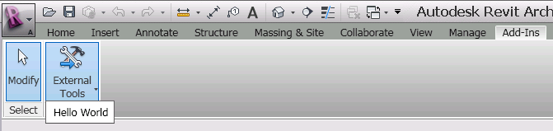
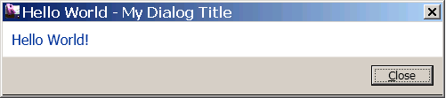
External Tools Panel Run Your Add-in
Once .addin manifest is in place, you will see [Add-Ins] tab and [External Tools] panel. (not visible with no add-ins)
Run your command from the pull down menu

Slide 25
Carrying On …
External application and external command data
Notes:
That concludes the introduction. Now let us start looking at real development issues and take our first steps up to a simple “Hello World” example. The accompanying labs demonstrate the concepts discussed. They can also be used for self-learning, and as a reference to answer the most common Revit API beginner’s questions.

Slide 26
External Application Minimum Code in VB.NET
<VB.NET>
'' Hello World App - minimum external application
<Transaction(TransactionMode.Automatic)> _
<Regeneration(RegenerationOption.Manual)> _
Public Class HelloWorldApp
Implements IExternalApplication
'' OnShutdown() - called when Revit ends.
Public Function OnShutdown(ByVal application As UIControlledApplication) _ As Result _
Implements IExternalApplication.OnShutdown
Return Result.Succeeded
End Function
'' OnStartup() - called when Revit starts.
Public Function OnStartup(ByVal application As UIControlledApplication) _
As Result _
Implements IExternalApplication.OnStartup
TaskDialog.Show("My Dialog Title", "Hello World from App!")
Return Result.Succeeded
End Function
End Class
</VB.NET>
Impliment IExternalApplication
OnShutdown is called when Revit ends
OnStartup is called when Revit starts

Slide 27
External Application Minimum Code in VB.NET
<C#>
// Hello World #3 - minimum external application
[Transaction(TransactionMode.Automatic)]
[Regeneration(RegenerationOption.Manual)]
public class HelloWorldApp : IExternalApplication
{
// OnShutdown() - called when Revit ends.
public Result OnShutdown(UIControlledApplication application)
{
return Result.Succeeded;
}
// OnStartup() - called when Revit starts.
public Result OnStartup(UIControlledApplication application)
{
TaskDialog.Show("My Dialog Title", "Hello World from App!");
return Result.Succeeded;
}
}
</C#>

Slide 28
External Application .addin Manifest
Type = “Application” instead of “Command”
“Name” instead of “Text”
<AddIn Type="Application">
<Name>Hello World App</Name>
<FullClassName>RevitIntroVB.HelloWorldApp</FullClassName>
<Assembly>D:\RevitAPI 2011\Training\Labs\Revit Intro Labs\RevitIntro\RevitIntroVB\bin\Debug\RevitIntroVB.dll</Assembly>
<AddInId>08E8EFB1-FCC1-4b99-AD14-93523EE229AA</AddInId>
</AddIn>

Slide 29
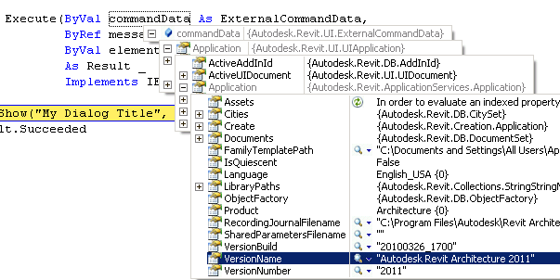
Command Data Access to the Revit Object Model
ExternalCommandData = 1st argument of Execute() method
Top most object that allows us to access a Revit model

Slide 30
Command Data Access to the Revit Object Model
Examples:
'' access to the version of Revit and the title of the document currently in use
Dim versionName As String = _ commandData.Application.Application.VersionName
Dim documentTitle As String = _ commandData.Application.ActiveUIDocument.Document.Title
'' print out wall types available in the current rvt project
Dim wallTypes As WallTypeSet = _
commandData.Application.ActiveUIDocument.Document.WallTypes
Dim s As String = ""
For Each wType As WallType In wallTypes
s = s + wType.Name + vbCr
Next

Slide 31
CommandData Access to the Revit Object Model
Access to Application and Document in DB and UI portions
<VB.NET>
Public Class DBElement
Implements IExternalCommand
'' member variables
Dim m_rvtApp As Application
Dim m_rvtDoc As Document
Public Function Execute(ByVal commandData As ExternalCommandData, _
...
'' Get the access to the top most objects.
Dim rvtUIApp As UIApplication = commandData.Application
Dim rvtUIDoc As UIDocument = rvtUIApp.ActiveUIDocument
m_rvtApp = rvtUIApp.Application
m_rvtDoc = rvtUIDoc.Document
'' ... </VB.NET>

Slide 32
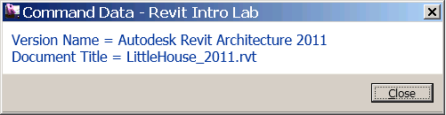
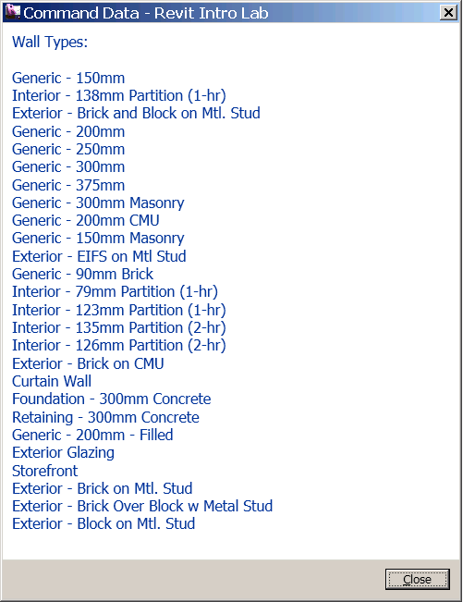
Lab1 – Hello World: external command and application
Objective: learn THE basics of Revit API.
Implement an external command/application
Implement an external application
Apply attributes
Write an add-in manifest file
Access to the Revit object model
Classes and methods:
IExternalCommand
IExternalApplication
OnStartup()
OnShutdown()
Attributes
TransactionMode
RegenerationOption
ExternalCommandData

Slide 33
Tools
Revit Lookup, Add-In Manager, SDKSamples2011.sln, and RvtSamples
Notes:
That concludes the introduction. Now let us start looking at real development issues and take our first steps up to a simple “Hello World” example. The accompanying labs demonstrate the concepts discussed. They can also be used for self-learning, and as a reference to answer the most common Revit API beginner’s questions.

Slide 34
Tools Must Know
RevitLookup – allows you to “snoop” into the Revit database structure. “must have” for any Revit API programmers.
Add-In Manager – allows you to load unload your dll while running Revit, and to run command without registering an addin
SDKSamples2011.sln – allows you to build all the sample projects at once. RevitAPIDllsPathUpdater.exe is provided to update the location of references in each MSVS projects in case your installation of Revit is different from the default location or if you are using different verticals.
RvtSamples – application that creates a ribbon panel for all the samples for easy testing

Slide 35
Demo
Include demo as needed or
Point to it on the Add-ins tab on your installation.

Slide 36
Revit Intro Labs Exercises
Exercises to learn the fundamentals of Revit API:
Lab1 – Hello world: external command and application
Lab2 – DB element
Lab3 – element filtering
Lab4 – element modifications
Lab5 – model creation

Slide 37
DB Element
Understanding the Representation of Revit Element
Notes:
That concludes the introduction. Now let us start looking at real development issues and take our first steps up to a simple “Hello World” example. The accompanying labs demonstrate the concepts discussed. They can also be used for self-learning, and as a reference to answer the most common Revit API beginner’s questions.

Slide 38
DB Element Element Basics
In typical programming, we identify the given object by checking its class names. Does the same apply to Revit API?
Answer is “no”
Let’s take a look to understand why …

Slide 39
DB Element Class Derivations
API Object
Element
Family Base
Symbol
Group
Instance
HostObject
Family
Group Type
HostObject Attributes
Insertable Object
Insertable Instance
Wall
Floor
Family Symbol
Family Instance
Clg. & Flr
Wall Type
Floor Type
Cont. Footing Type
Cont. Footing
RoofBase
Families and types, aka symbols
Host and component objects, standard and system
Notes:
Here is a smaller subset of the most important database classes, i.e. non-geometrical classes, that appear in a typical Revit model programming task. The red classes are the most commonly used. The RoofBase class and its derived types FootPrintRoof and ExtrusionRoof were added in Revit 2009. In the model, we see the host and component objects, such as windows and doors. These are actually instances of types. The family base and family are used to manage collections of related types. Symbol is a base class for all types, also known as symbols. Family symbol is the generic class for these, whereas wall and floor type are more specialised classes. Family instance represents an occurrence or usage instance of a generic family symbol, whereas wall and floor represent the same for a wall or floor type.

Slide 40
DB Element Element versus Symbol
Element |  |  |  | Symbol
Kind of Element in UI | Derived from Element/TypeOf | Category |  | Derived from Symbol/TypeOf | Category
Wall | HostObject/Wall | Walls |  | HostObjAttributes/WallType | Walls
Door | Instance/InsertableInstance/FamilyInstance | Doors |  | InsertableObject /FamilySymbol | Doors
Door Tag | IndependentTag | Door Tags |  | InsertableObject /FamilySymbol | Door Tags
Window | Instance/InsertableInstance/FamilyInstance | Windows |  | InsertableObject /FamilySymbol | Windows
WindowTag | IndependentTag | Window Tags |  | InsertableObject /FamilySymbol | Window Tags
Opening | Opening | Rectangular Straight Wall Opening |  | < null > | ---
Floor | HostObject/Floor | Floors |  | HostObjAttributes/FloorType | Floors
Ceiling | < Element > | Ceilings |  | HostObjAttributes | Ceilings
Roof | HostObject/RoofBase/FootPrintRoof,ExtrusionRoof | Roofs |  | HostObjAttributes/RoofType | Roofs
Column | Instance/InsertableInstance/FamilyInstance | Columns |  | InsertableObject /FamilySymbol | Columns
Component (Desk) | Instance/InsertableInstance/FamilyInstance | Furniture |  | InsertableObject /FamilySymbol | Furniture
Component (Tree) | Instance/InsertableInstance/FamilyInstance | Planting |  | InsertableObject /FamilySymbol | Planting
Stairs | < Element > | Stairs |  | < Symbol > | Staies
Railing | < Element > | Railings |  | < Symbol > | Railings
Room | Room | Rooms |  | < null > | ---
Room Tag | RoomTag | Room Tags |  | < Symbol > | Room Tags
Grid | Grid | Grids |  | LineAndTextAttrSymbol/GridType | < null >
Lines | ModelCurve/ModelLine | Lines |  | < null > | ---
Ref Plane | ReferencePlane | Reference Planes |  | < null > | ---
Dimension | Dimension | Dimensions |  | DimensionType | < null >
Section | < Element > | Views |  | < Symbol > | < null >
Text | TextElement/TextNote | Text Notes |  | LineAndTextAttrSymbol/TextElementType/TextNoteType | < null >
Level | Level | Levels |  | LevelType | Levels
Model Group | Group | Model Group |  | GroupType | Model Groups
Create…/Walls | Instance/InsertableInstance/FamilyInstance | Walls |  | InsertableObject /FamilySymbol | Walls
Notes:
The second table shows a similar list with the symbol type and its corresponding category added. The two columns on the right show the type and category of the symbol or family type used for each model elmeent, represented by a family or dedicated type instance. It shows the correspondence between the instance and symbol elements. The symbol used for a wall is WallType, floor uses FloorType, roof uses RoofType. For component families such as door, window, column, desk and tree, the symbol type is FamilySymbol. Again, in these cases you need to rely on the category to tell the different family symbols apart, while there are designed types for system families.

Slide 41
DB Element Identifying Element
A system family is a built-in object in Revit. There is a designated class for it. You can use it to identify the element.
A component family has a generic form as FamilyInstance/FamilySymbol. Category is the way to further identify the kind of object it is representing in Revit.
Depending on an element you are interested in, you will need to check the following:
Class name
Category property
If an element is Element Type (Symbol) or not
 | System Family | Component Family
Family Type | WallType FloorType | FamilySymbol & Category - Doors, Windows
Instance | Wall Floor | FamilyInstance & Category - Doors, Windows

Slide 42
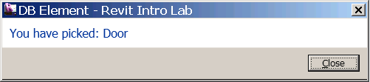
DB Element Identifying an Element
<VB.NET>
'' identify the type of the element known to the UI.
Public Sub IdentifyElement(ByVal elem As Element)
Dim s As String = ""
If TypeOf elem Is Wall Then
s = "Wall"
ElseIf TypeOf elem Is Floor Then
s = "Floor"
ElseIf TypeOf elem Is RoofBase Then
s = "Roof"
ElseIf TypeOf elem Is FamilyInstance Then
'' An instance of a component family is all FamilyInstance.
'' We'll need to further check its category.
If elem.Category.Id.IntegerValue = _
BuiltInCategory.OST_Doors Then
s = "Door"
ElseIf elem.Category.Id.IntegerValue = _
BuiltInCategory.OST_Windows Then
s = "Window"
ElseIf elem.Category.Id.IntegerValue = _
BuiltInCategory.OST_Furniture Then
s = "Furniture"
Else
s = "Component family instance" '' e.g. Plant
End If
...
</VB.NET>
DB Element Identifying Element
ABC

Slide 43
DB Element Element.Parameters
Parameters property of an Element class largely corresponds to an element or family “properties” in the UI.
In API, there are two ways to access those properties or parameters:
Element.Parameters – returns a set of parameters applicable to the given element.
Element.Parameter – takes an argument that can identify the kind of parameter and returns the value of single parameter.

Slide 44
DB Element Element.Parameters
<VB.NET>
'' show all the parameter values of the element
Public Sub ShowParameters(ByVal elem As Element, _ Optional ByVal header As String = "")
Dim s As String = header + vbCr + vbCr
Dim params As ParameterSet = elem.Parameters
For Each param As Parameter In params
Dim name As String = param.Definition.Name
'' see the helper function below
Dim val As String = ParameterToString(param)
s = s + name + " = " + val + vbCr
Next
TaskDialog.Show("Revit Intro Lab", s)
End Sub
</VB.NET>
ABC

Slide 45
DB Element Parameters
<VB.NET>
'' Helper function: return a string from of a given parameter.
Public Shared Function ParameterToString(ByVal param As Parameter) As String
Dim val As String = "none"
If param Is Nothing Then
Return val
End If
'' to get to the parameter value, we need to pause it depending on
'' its strage type
Select Case param.StorageType
Case StorageType.Double
Dim dVal As Double = param.AsDouble
val = dVal.ToString
Case StorageType.Integer
Dim iVal As Integer = param.AsInteger
val = iVal.ToString()
Case StorageType.String
Dim sVal As String = param.AsString
val = sVal
Case StorageType.ElementId
Dim idVal As ElementId = param.AsElementId
val = idVal.IntegerValue.ToString
Case StorageType.None
Case Else
End Select
Return val
End Function
</VB.NET>
ABC

Slide 46
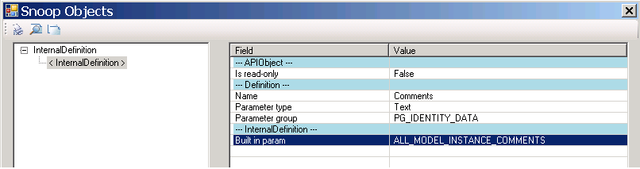
DB Element Element.Parameter and Built-In Parameters
There are four ways to access individual parameters:
Parameter(BuiltInParameter) – retrieve a parameter using the parameter Id.
Parameter(String) – retrieve using the name.
Parameter(Definition) – retrieve from its definition.
Parameter(GUID) – retrieve shared parameter using GUID.
RevitLookup tool comes handy to explore and find out which BuiltInParameter corresponds to which parameter name
Notes:
Here we’ll look at the first and second.

Slide 47
DB Element Element.Parameter and Built-In Parameters
<VB.NET>
'' examples of retrieving a specific parameter individlly.
Public Sub RetrieveParameter(ByVal elem As Element, _ Optional ByVal header As String = "")
Dim s As String = header + vbCr + vbCr
'' comments - most of instance has this parameter
'' (1) by name. (Mark - most of instance has this parameter.)
param = elem.Parameter("Mark")
...
'' (2) by BuiltInParameter.
Dim param As Parameter = _ elem.Parameter(BuiltInParameter.ALL_MODEL_INSTANCE_COMMENTS)
...
'' using the BuiltInParameter, you can sometimes access one
'' that is not in the parameters set.
param = elem.Parameter(BuiltInParameter.SYMBOL_FAMILY_AND_TYPE_NAMES_PARAM)
...
param = elem.Parameter(BuiltInParameter.SYMBOL_FAMILY_NAME_PARAM)
...
</VB.NET>
ABC

Slide 48
DB Element Location
Location property
Location is further derived in two forms:
LocationPoint - point-based location (e.g., furniture)
LocationCurve – line-based location (e.g., wall)
You will need to cast to LocationPoint or LocationCurve in order to access more properties.

Slide 49
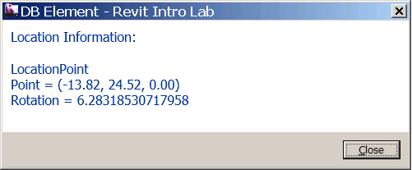
DB Element Location
<VB.NET>
'' show the location information of the given element.
Public Sub ShowLocation(ByVal elem As Element)
Dim s As String = "Location Information: " + vbCr + vbCr
Dim loc As Location = elem.Location
If TypeOf loc Is LocationPoint Then
'' (1) we have a location point
Dim locPoint As LocationPoint = loc
Dim pt As XYZ = locPoint.Point
Dim r As Double = locPoint.Rotation
...
ElseIf TypeOf loc Is LocationCurve Then
'' (2) we have a location curve
Dim locCurve As LocationCurve = loc
Dim crv As Curve = locCurve.Curve
...
s = s + "EndPoint(0)/Start Point = " + PointToString(crv.EndPoint(0))
s = s + "EndPoint(1)/End point = " + PointToString(crv.EndPoint(1))
s = s + "Length = " + crv.Length.ToString + vbCr
End If
…
End Sub
</VB.NET>

Slide 50
DB Element Geometry
Geometry Options – specify the detail level (Fine, Medium and Fine)
Kinds of Geometry object:
Solid
Geometry Instance (a instance of another element (symbol), such as a window and a door
Curve
Mesh.
Further drill down of Solids/Faces/Edges - use RevitLookup.
RevitCommands sample has a simple example.
The following samples show geometry access with a little viewer:
ElementViewer
RoomViewer
AnalyticalViewer

Slide 51
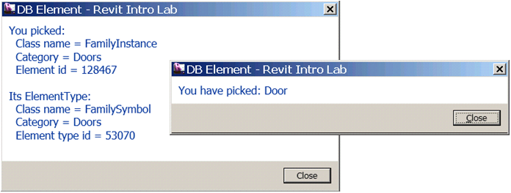
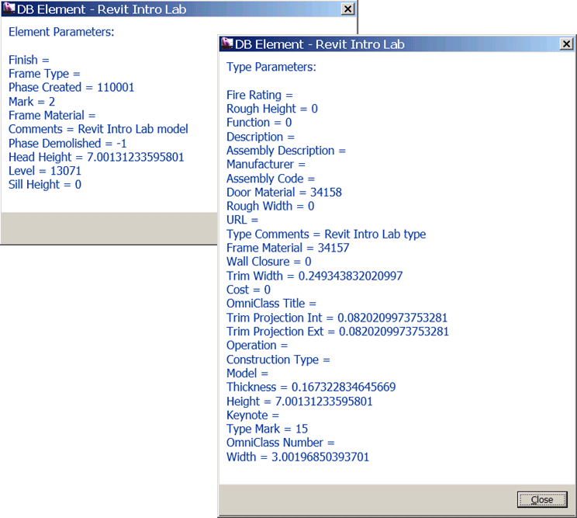
Lab2 – DB Element
Objective: learn how an element is represented in the Revit and how to retrieve information about it
Identify element
Retrieve:
a set of properties of an element
a specific property of an element
location information
geometry information
Classes and methods:
elem.GetType(), .Category(), .Id(), .GetTypeId()
Wall, Floor, RoofBase, FamilyInstance
WallType, FloorType, RoofType, FamilySymbol
Parameter
Location, LocationCurve, LocationPoint
GeometryElement

Slide 52
Element Filtering
Element Iterations, Filtering and Queries
Notes:
That concludes the introduction. Now let us start looking at real development issues and take our first steps up to a simple “Hello World” example. The accompanying labs demonstrate the concepts discussed. They can also be used for self-learning, and as a reference to answer the most common Revit API beginner’s questions.

Slide 53
Element Filtering Retrieving an Element
Elements in Revit is bundled in one sack
To retrieve an element of interest, you will need to iterate, filter and/or query them.
Typically, we would like to:
Retrieve a list of family types (e.g., wall types, door types)
Retrieve instances of a specific object class (e.g., all the walls, all the doors)
Find a specific family type with a given name (e.g., “Basic Wall: Generic – 200mm”, “M_Single-Flush: 0915 x 2134mm”)
Find specific instances (e.g., “Level 1” “View Plan 1”)
Similar to identifying element, you will need to consider a different approach depending on whether an element is a component-based or system-based.

Slide 54
Element Filtering 1.1 A List of Family Types - System Family
Collect all the wall types (2nd and 3rd using shortcuts)
<VB.NET>
Dim wallTypeCollector1 = New FilteredElementCollector(m_rvtDoc)
wallTypeCollector1.WherePasses(New ElementClassFilter(GetType(WallType)))
Dim wallTypes1 As IList(Of Element) = wallTypeCollector1.ToElements
</VB.NET>
<VB.NET>
Dim wallTypeCollector2 = New FilteredElementCollector(m_rvtDoc)
wallTypeCollector2.OfClass(GetType(WallType))
</VB.NET>
<VB.NET>
Dim wallTypeCollector3 = _ New FilteredElementCollector(m_rvtDoc).OfClass(GetType(WallType))
</VB.NET>

Slide 55
Element Filtering 1.2 A List of Family Types - Component Family
Collect all the door types
<VB.NET>
Dim doorTypeCollector = New FilteredElementCollector(m_rvtDoc)
doorTypeCollector.OfClass(GetType(FamilySymbol))
doorTypeCollector.OfCategory(BuiltInCategory.OST_Doors)
Dim doorTypes As IList(Of Element) = doorTypeCollector.ToElements
</VB.NET>

Slide 56
Element Filtering 2.1 List of Instances of a Specific Object Class - System Family
Collect all the instances of wall
<VB.NET>
Dim wallCollector = New FilteredElementCollector(m_rvtDoc).OfClass(GetType(Wall))
Dim wallList As IList(Of Element) = wallCollector.ToElements
</VB.NET>

Slide 57
Element Filtering 2.2 List of Instances of a Specific Object Class - Component Family
Collect all the instances of door
<VB.NET>
Dim doorCollector = New FilteredElementCollector(m_rvtDoc). _ OfClass(GetType(FamilyInstance))
doorCollector.OfCategory(BuiltInCategory.OST_Doors)
Dim doorList As IList(Of Element) = doorCollector.ToElements
</VB.NET>

Slide 58
Element Filtering 3.1 Find a Specific Family Type – System Family Type
Find a wall type e.g., “Basic Wall: Generic – 200mm”
<VB.NET>
Function FindFamilyType_Wall_v1(ByVal wallFamilyName As String, _
ByVal wallTypeName As String) As Element
'' narrow down a collector with class.
Dim wallTypeCollector1 = New FilteredElementCollector(m_rvtDoc)
wallTypeCollector1.OfClass(GetType(WallType))
'' LINQ query
Dim wallTypeElems1 = _
From element In wallTypeCollector1 _
Where element.Name.Equals(wallTypeName) _
Select element
'' get the result.
Dim wallType1 As Element = Nothing '' result will go here.
If wallTypeElems1.Count > 0 Then
wallType1 = wallTypeElems1.First
End If
Return wallType1
End Function
</VB.NET>

Slide 59
Element Filtering 3.2 Find a Specific Family Type – Component Family
<VB.NET>
Function FindFamilyType_Door_v1(ByVal doorFamilyName As String, ByVal doorTypeName As String) As Element
'' narrow down the collection with class and category.
Dim doorFamilyCollector1 = New FilteredElementCollector(m_rvtDoc)
doorFamilyCollector1.OfClass(GetType(FamilySymbol))
doorFamilyCollector1.OfCategory(BuiltInCategory.OST_Doors)
'' parse the collection for the given name using LINQ query here.
Dim doorTypeElems = _
From element In doorFamilyCollector1 _
Where element.Name.Equals(doorTypeName) And _
element.Parameter(BuiltInParameter.SYMBOL_FAMILY_NAME_PARAM). _ AsString.Equals(doorFamilyName) _
Select element
'' get the result.
Dim doorType1 As Element = Nothing
Dim doorTypeList As IList(Of Element) = doorTypeElems.ToList()
If doorTypeList.Count > 0 Then '' we should have only one.
doorType1 = doorTypeList(0) ' found it.
End If
Return doorType1
End Function
</VB.NET>
Find a door type, e.g., “M_Single-Flush: 0915 x 2134”

Slide 60
Element Filtering 4.1 Find Instances of a Given Family Type
e.g., Find doors with a given type “M_Single-Flush: 0915 x 2134”
<VB.NET>
'' Find a list of element with the given Class, family type and Category (optional).
Function FindInstancesOfType(ByVal targetType As Type, _ ByVal idFamilyType As ElementId, _
Optional ByVal targetCategory As BuiltInCategory = Nothing) As IList(Of Element)
'' narrow down to the elements of the given type and category
Dim collector = New FilteredElementCollector(m_rvtDoc).OfClass(targetType)
If Not (targetCategory = Nothing) Then
collector.OfCategory(targetCategory)
End If
'' parse the collection for the given family type id. using LINQ query here.
Dim elems = _
From element In collector _
Where element.Parameter(BuiltInParameter.SYMBOL_ID_PARAM). _
AsElementId.Equals(idType) _
Select element
'' put the result as a list of element for accessibility.
Return elems.ToList()
End Function
</VB.NET>

Slide 61
Element Filtering 4.2 Find Elements with a Given Class and Name
Find levels with a given name
<VB.NET>
'' Find a list of elements with given class, name, category (optional).
Public Shared Function FindElements(ByVal rvtDoc As Document, _
ByVal targetType As Type, ByVal targetName As String, _
Optional ByVal targetCategory As BuiltInCategory = Nothing) As IList(Of Element)
'' narrow down to the elements of the given type and category
Dim collector = _ New FilteredElementCollector(rvtDoc).OfClass(targetType)
If Not (targetCategory = Nothing) Then
collector.OfCategory(targetCategory)
End If
'' parse the collection for the given names. using LINQ query here.
Dim elems = _
From element In collector _
Where element.Name.Equals(targetName) _
Select element
'' put the result as a list of element for accessibility.
Return elems.ToList()
End Function
</VB.NET>

Slide 62
Element Filtering More Options
We have learned how to use the following classes:
FilteredElementCollector
ElementClassFilter
ElemetCategoryFilter
There are more different kinds of filters, such as:
BoundingBoxContainsPointFilter
ElementDesignOptionFilter
ElementIsCurveDrivenFilter
ElementIsElementTypeFilter
ElementParameterFilter
…
cf. Section 6 (pp77 ~ 88) of Developer Guide.

Slide 63
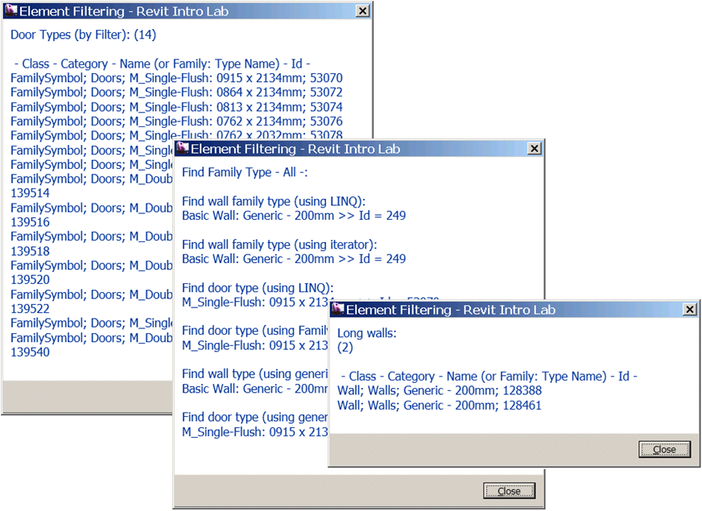
Lab3 – Element Filtering
Objective: learn how to filter elements
Retrieve family types
Retrieve instances of a specific object type
Find specific family type
Find specific instances
You will need lots of hands-on exercise for filtering
Classes and methods:
rvtDoc.WallTypes
FilteredElementCollector
ElementClassFilter
ElementCategoryFilter
ElementParameterFilter
FilteredElementIterator
LINQ query

Slide 64
Element Modification
How to modify an element
Notes:
That concludes the introduction. Now let us start looking at real development issues and take our first steps up to a simple “Hello World” example. The accompanying labs demonstrate the concepts discussed. They can also be used for self-learning, and as a reference to answer the most common Revit API beginner’s questions.

Slide 65
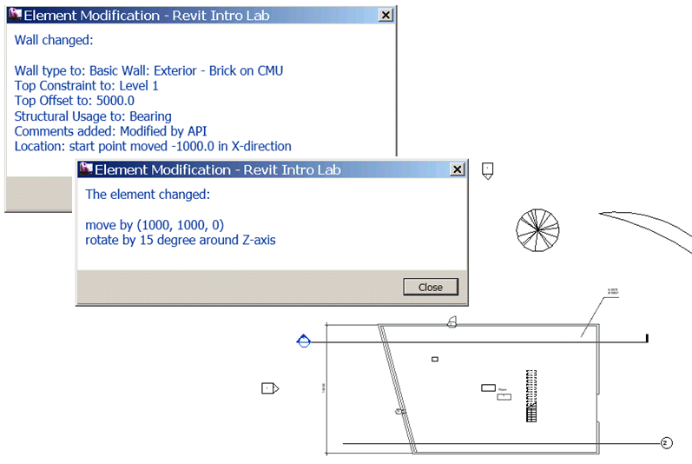
Element Modification Element Level vs. Document Level Modification
Two approaches to modify an element:
by changing its properties, parameters and location at each element level
using Document level methods, such as Move and Rotate
At each element level, you can change:
Family type
Parameters
Location
By Document methods:
Move, Rotate, Mirror, Array, Array without associate (this will not create a group)

Slide 66
Element Modification Element Level – Family Type
Change the family type of an instance (e.g., a wall and a door)
<VB.NET>
'' e.g., an element we are given is a wall.
Dim aWall As Wall = elem
'' find a wall family type with the given name.
Dim newWallType As Element = ElementFiltering.FindFamilyType( m_rvtDoc, _
GetType(WallType), "Basic Wall", "Exterior - Brick on CMU")
'' assign a new family type.
aWall.WallType = newWallType
</VB.NET>
<VB.NET>
'' e.g., an element we are given is a door.
Dim aDoor As FamilyInstance = elem
'' find a door family type with the given name.
Dim newDoorType As Element = ElementFiltering.FindFamilyType( _
GetType(FamilySymbol), "M_Single-Flush", "0762 x 2032mm", _ BuiltInCategory.OST_Doors)
'' assign a new family type.
aDoor.Symbol = newDoorType
</VB.NET>

Slide 67
Element Modification Element Level – Parameter
Change a parameter of an element (e.g., a wall and a door)
<VB.NET>
aWall.Parameter(BuiltInParameter.WALL_TOP_OFFSET).Set(14.0)
aWall.Parameter(BuiltInParameter.ALL_MODEL_INSTANCE_COMMENTS).Set( _ "Modified by API")
</VB.NET>

Slide 68
Element Modification Element Level – Location Curve
Change a value of location information (e.g., a wall)
<VB.NET>
Dim wallLocation As LocationCurve = aWall.Location
'' create a new line bound.
Dim newPt1 = New XYZ(0.0, 0.0, 0.0)
Dim newPt2 = New XYZ(20.0, 0.0, 0.0)
Dim newWallLine As Line = m_rvtApp.Create.NewLineBound(newPt1, newPt2)
'' change the curve.
wallLocation.Curve = newWallLine
</VB.NET>

Slide 69
Element Modification Document Level – Move and Rotate
Move and rotate an element (e.g., a wall)
<VB.NET>
'' move by displacement
Dim v As XYZ = New XYZ(10.0, 10.0, 0.0)
m_rvtDoc.Move(elem, v)
</VB.NET>
<VB.NET>
'' rotate by 15 degree around z-axis.
Dim pt1 = XYZ.Zero
Dim pt2 = XYZ.BasisZ
Dim axis As Line = m_rvtApp.Create.NewLineBound(pt1, pt2)
m_rvtDoc.Rotate(elem, axis, Math.PI / 12.0)
</VB.NET>

Slide 70
Element Modification Regeneration of Graphics
When you modify an element that results changes in a model geometry and you need to access to the updated geometry, the graphics need to be regenerated.
You can control this by calling Document.Regenerate() method with Attributes setting RegenerationOption.Manual.
When RegenerationOption.Automatic is used, Revit will try its best to update graphics whenever needed.
m_rvtDoc.Regenerate()

Slide 71
Lab4 – Element Modification
Objective: learn how to modify elements
Modify an element’s properties, parameters and location
Modify an element using Document level methods
Classes and methods:
aWall.WallType, aDoor.Symbol
aWall.Parameter( BuiltInParameter.WALL_TOP_OFFSET).Set(14.0)
LocationCurve
LocationPoint
rvtApp.Create.NewLineBound(pt1, pt2)
rvtDoc.Move(), .Rotate()
rvtDoc.Regenerate()

Slide 72
Model Creation
How to create instances of Revit elements
Notes:
That concludes the introduction. Now let us start looking at real development issues and take our first steps up to a simple “Hello World” example. The accompanying labs demonstrate the concepts discussed. They can also be used for self-learning, and as a reference to answer the most common Revit API beginner’s questions.

Slide 73
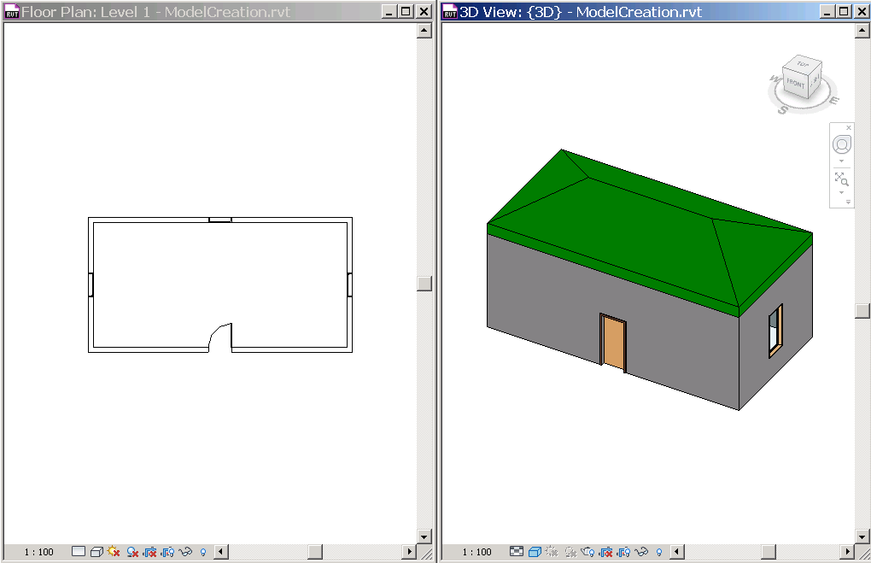
Model Creation Create Instances of Revit Elements
Create a new geometry element:
Application.Create.NewXxx() e.g., NewLineBound()
Create a new model element:
Document.Create.NewXxx() e.g., NewWall(), NewFamilyInstance()
Multiple overloaded methods, each for a specific condition and/or apply only certain types of elements.
e.g., 5 NewWall(), 9 NewFamilyInstance()
cf. Dev Guide p177

Slide 74
Model Creation Create a Wall
Model Creation New Walls
<VB.NET> '' create walls
Sub CreateWalls()
'' get the levels we want to work on.
Dim level1 As Level = ElementFiltering.FindElement(m_rvtDoc, GetType(Level), "Level 1")
Dim level2 As Level = ElementFiltering.FindElement(m_rvtDoc, GetType(Level), "Level 2")
'' set four corner of walls.
Dim pts As New List(Of XYZ)(5)
...
Dim isStructural As Boolean = False '' flag for structural wall or not.
'' loop through list of points and define four walls.
For i As Integer = 0 To 3
'' define a base curve from two points.
Dim baseCurve As Line = m_rvtApp.Create.NewLineBound(pts(i), pts(i + 1))
'' create a wall using the one of overloaded methods.
Dim aWall As Wall = m_rvtDoc.Create.NewWall(baseCurve, level1, isStructural)
'' set the Top Constraint to Level 2
aWall.Parameter(BuiltInParameter.WALL_HEIGHT_TYPE).Set(level2.Id)
Next
'' This is important. we need these lines to have shrinkwrap working.
m_rvtDoc.Regenerate()
m_rvtDoc.AutoJoinElements()
End Sub </VB.NET>

Slide 75
Model Creation Create a Wall
Model Creation A New Door
<VB.NET>
'' add a door to the center of the given wall.
Sub AddDoor(ByVal hostWall As Wall)
'' get the door type to use.
Dim doorType As FamilySymbol = _
ElementFiltering.FindFamilyType(m_rvtDoc, GetType(FamilySymbol), _ "M_Single-Flush", "0915 x 2134mm", BuiltInCategory.OST_Doors)
'' get the start and end points of the wall.
Dim locCurve As LocationCurve = hostWall.Location
Dim pt1 As XYZ = locCurve.Curve.EndPoint(0)
Dim pt2 As XYZ = locCurve.Curve.EndPoint(1)
'' calculate the mid point.
Dim pt As XYZ = (pt1 + pt2) / 2.0
'' we want to set the reference as a bottom of the wall or level1.
Dim idLevel1 As ElementId = _
hostWall.Parameter(BuiltInParameter.WALL_BASE_CONSTRAINT).AsElementId
Dim level1 As Level = m_rvtDoc.Element(idLevel1)
'' finally, create a door.
Dim aDoor As FamilyInstance = m_rvtDoc.Create.NewFamilyInstance( _
pt, doorType, hostWall, level1, StructuralType.NonStructural)
End Sub
</VB.NET>

Slide 76
Shared Parameter

Slide 77
Lab5 – Model Creation
Objective: learn how to create a Revit model
Create instances of architectural elements
Classes and methods:
rvtDoc.Create.NewWall()
rvtDoc.Create.NewFamilyInstance()
rvtDoc.Create.NewFootPrintRoof()
rvtDoc.Regenerate()
rvtDoc.AutoJoinElements()

Slide 78
Revit API Intro Labs
Revit API fundamentals
Revit Add-ins: external command/application, attributes, add-in manifest and object model
Representation of Revit elements
Element iteration, filtering and queries
Element modification
Model creation
Exercises:
Lab1 – “Hello World”
Lab2 – DB element
Lab3 – element filtering
Lab4 – element modification
Lab5 – model creation

Slide 79
Revit API Getting Started Samples
[You can list some samples that you can recommend as a good starting point here]

Slide 80
Taking a break for 5 min…

Slide 81
Revit UI
Ribbon, selection, task dialog and event and dynamic model update
Notes:
That concludes the introduction. Now let us start looking at real development issues and take our first steps up to a simple “Hello World” example. The accompanying labs demonstrate the concepts discussed. They can also be used for self-learning, and as a reference to answer the most common Revit API beginner’s questions.

Slide 82
Saikat’s ppt come here

Slide 83
Conclusion
Where do we go next …
Notes:
That concludes the introduction. Now let us start looking at real development issues and take our first steps up to a simple “Hello World” example. The accompanying labs demonstrate the concepts discussed. They can also be used for self-learning, and as a reference to answer the most common Revit API beginner’s questions.

Slide 84
Where do we go next
Put information about:
DevCamp
DevLab
Avilable materials

Slide 85
Announcements comes here
API wishlist survey till May 30
DevCamp
DevLabs Waltham, MA
DevLabs Germany
DevLabs where else?
List of other training schedules?
Waltham/China/Bangalore/Brazil?

Slide 86
Polls

Slide 87
Thank you message comes here

Slide 88


